Slide 1
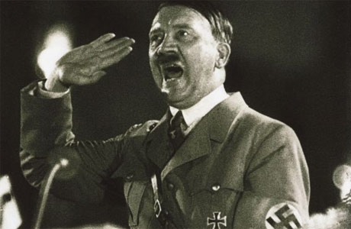
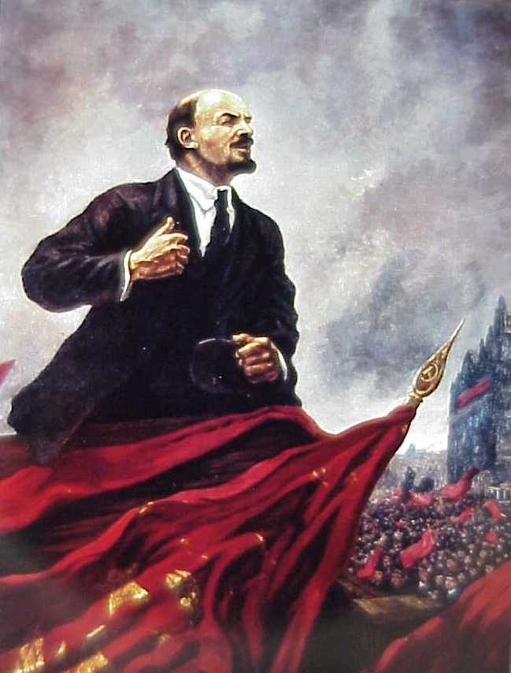
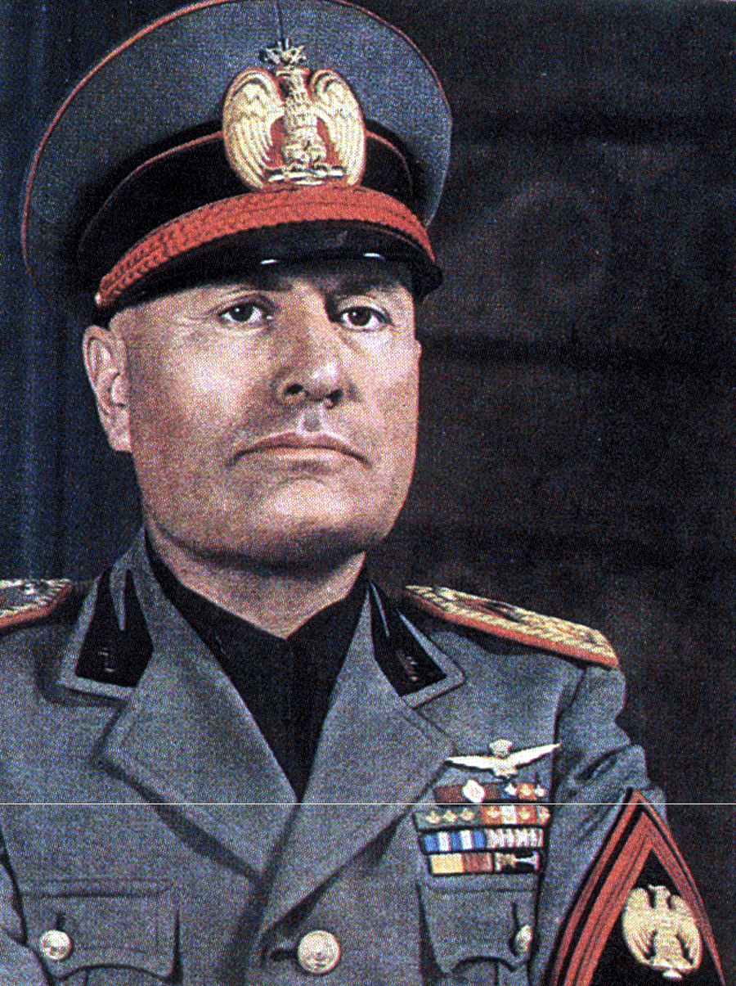
Totalitarianism
Adolf Hitler
Benito Mussolini
V.I. Lenin

Slide 2
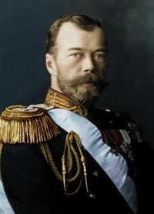
Problems in Russia
A majority of the population in Russia were peasants
Czar Nicholas II was reluctant to change
Russian Parliament = Duma
The Duma had no real power
Russia was a totalitarian state
All totalitarian governments have secret police
Russia’s was corrupt
Czar Nicholas II
Notes:
Russian Revolution was a political revolution
Why did Russia pull out of WWI?
Was Nicholas excited to rule Russia?
The Duma was a Russian parliament, but had no power.

Slide 3
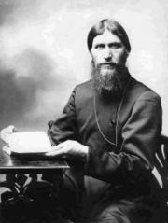
WWI and Russia
Russian army poorly equipped
This led to huge casualty rates
Czar goes to the front
Czar leaves Alexandra (Czarina) and Rasputin to run the Govt.
The Russian citizens viewed this govt. as corrupt
Notes:
Why was Rasputin around the family in the first place?
Who was sick and what was his disease? The Czar’s son Alexi – Hemophilia
Rasputin’s reputation was not good. He was a heavy drinker and womanizer.

Slide 4
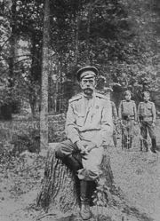
March Revolution – 1st Revolution - 1917
Sometimes known as the February revolution
St. Petersburg – bread riots
Disasters at war, workers strike
Czar abdicated
Duma set up a provisional govt.
Alexander Kerensky was its leader
He continued at war
Soviets (councils of workers) – controlled by Bolsheviks
Czar Nicholas II hiding out after abdicating
Notes:
The Russian calendar in 1917 was 13 days behind so the revolutions are known as Feb/Oct as well
Not enough food to feed everyone
Abdicate means to step down
Alexander Kerensky’s first major decision was to keep in the war with Germany despite a popular opinion to do so.
Russia is mostly farm land. It’s huge. Council of workers decide the prices of the local economy. The Bolsheviks control the council of workers.

Slide 5
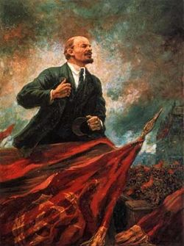
Lenin
Leader of the Bolsheviks
Hated Czarist Govt.
His brother threatened to kill the Czar so he was executed by the Czarist Govt.
Read Karl Marx
Led demonstrations
Lenin Speech
Arrested and sent to Siberia
Eventually exiled to Switzerland
Germany helps sneak Lenin back to Russia knowing that he will pull them out of the war

Slide 6
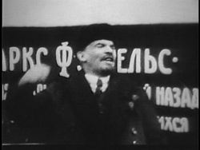
Lenin
Manipulated his Marxist ideas to adapt to Russia
Elite group needed to lead the revolution = Bolsheviks
Returned to Russia
March 1917 – Germany brought Lenin back
Notes:
Lenin changed Marx’s idea that the proletariat would lead the revolution. He decided an elite group of Bolsheviks would be best qualified to lead the revolution.
Who was Russia’s enemy during WWI? Germany
Germany was eager to help Lenin get back to Russia so Russia would pull out of the war.

Slide 7
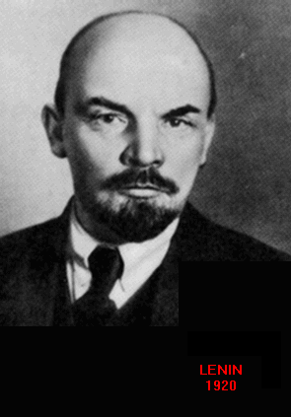
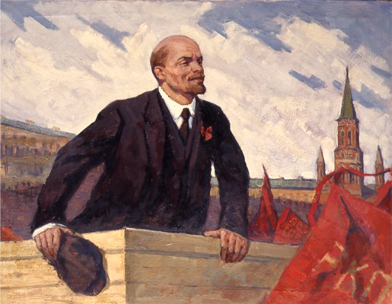
Lenin and the November Revolution – 2nd Revolution
Sometimes known as the October Revolution
Bolsheviks took control
November 1917 – Red Guards (armed factory workers) joined sailors in attacking provisional Govt.
Lenin’s forces took over within days
Provisional Govt. fell without a struggle

Slide 8
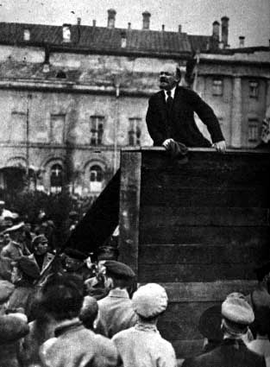
Bolsheviks in Charge
November Revolution is a bloodless revolution
Kerensky steps down
Bolsheviks move the capital from St. Petersburg to Moscow
The Kremlin became their Head Quarters
Bolsheviks renamed themselves the Communists
Notes:
The capital was St. Petersburg but when the Bolsheviks took over they moved the capital to Moscow. They did this to remove association from the old Czarist govt.
Anytime you see Bolsheviks you can think Communists

Slide 9
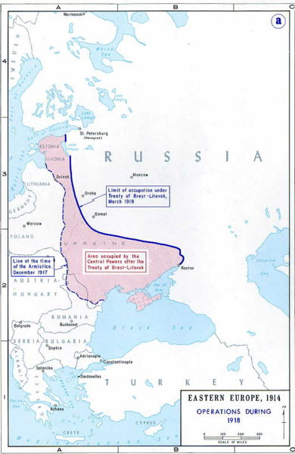
Under Siege
Lenin signs the Treaty of Brest-Litovsk – March 1918
Peace treaty with Germany
Russia gave up a large portion of its territory and population to Germany
Civil War in Russia – 1918 – 1921
Reds (Communists)
Whites (Czarists)
Notes:
Russia goes right from a revolution into a civil war. The allies wanted the Czarists to win the civil war. Who are the Allies? GB, France, US etc.

Slide 10
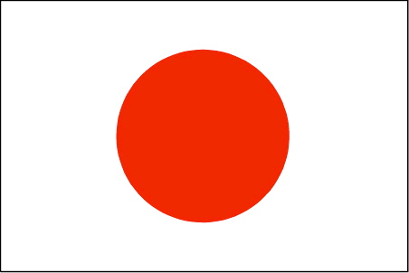
Allied Invasion
Allies wanted the whites (czarists) to win
Japan seized land in East Asia which the Czarist Russia owned
Britain, France, U.S., sent forces to help the Whites (Czarists)
Allied forces failed
Lenin continues his communist regime

Slide 11
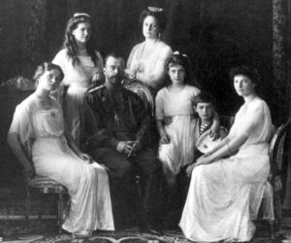
A Costly Triumph
The whites (Czarists) captured Communists
They tried to assassinate Lenin
This caused the Communists to organize their own secret police known as the “Cheka”
Czarists were executed
Czar Nicholas II was killed along with his wife and five children
Notes:
On August 30, 1918, Fanya Kaplan, a member of the Socialist Revolutionary Party, approached Lenin after he had spoken at a meeting and was on the way to his car. He had his foot on the running board. She called out to Lenin, who turned to answer. She immediately fired three shots: one,relatively harmless, lodged in the arm; the second, possibly fatal, at the juncture of the jaw and neck, the third striking a woman who was talking with Lenin when the shots were fired.
The whole family was shot, stabbed and beaten to death. This was to prove a point that they never want a Czarist govt. again

Slide 12
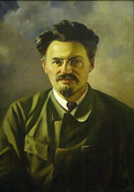
A Costly Triumph
War Communism
Communists took over banks, mines, factories and railroads
Leon Trotsky – Leader of the Red Army
Every 10th man order
Civil War ended in 1921
Communists (Reds) won, but Russia still in chaos
Leon Trotsky
Notes:
Trotsky kind of looks like Sean Penn
Trotsky used a tactic that dated back to ancient Rome. Every 10th man.
The bullet from the assignation attempt was still lodged in his neck, too close to his spine for medical techniques of the time to remove. In May 1922, Lenin had his first stroke. He was left partially paralyzed on his right side, and his role in government declined. After the second stroke in December of the same year, he resigned from active politics. In March 1923, he suffered his third stroke and was left bedridden for the remainder of his life, no longer able to speak. He finally died in January of 1924 of a fourth stroke.
Who replaces Lenin? Stalin. Stalin is appointed by the Communist party. There is no democracy in Communism which is one of the reasons the US dislikes Communism.

Slide 13
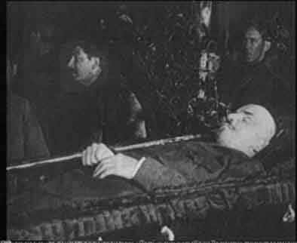
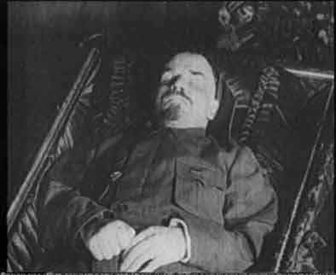
A Costly Triumph
A bullet from the assassination attempt was still lodged in his neck
Bullet too close to the spine to operate
This causes his first stroke in 1922 – partially paralyzed
Lenin has 2nd stroke later that year and resigns from politics
Third stroke leaves him speechless
Dies from Fourth stroke
Communist party appoints Joseph Stalin
Notes:
In March 1923, he suffered his third stroke and was left bedridden for the remainder of his life, no longer able to speak. He finally died in January of 1924 of a fourth stroke.

Slide 14
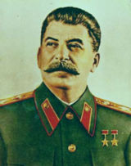
“A single death is a tragedy, one million deaths is a statistic.” -Joseph Stalin
Joseph Stalin
Notes:
Borat

Slide 15
1918

Slide 16
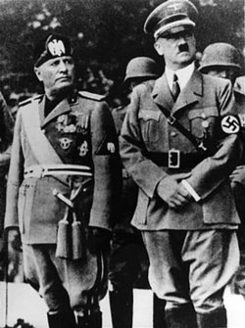
Fascism in Italy

Slide 17
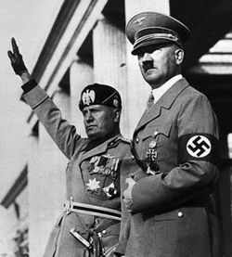
What is Fascism?
Fascism is based on the Latin word Fasces – sticks in a bundle wrapped around an axe. Together we are strong, separate we are week.
Extreme nationalism and blind loyalty to the state
Anti-Democratic – Nation comes before individual
Aggressive foreign expansion – Social Darwinism

Slide 18
What is Fascism?
Totalitarian ruler is always right
Compared to Communism
Communists – hopes for international change, world revolution of workers, won support among urban and agricultural workers (Poor people support)
Fascists – pursued nationalistic goals, won support among business leaders, wealthy landowners, lower middle class (Rich people support)
Similarities – Flourished during economic hard times by promoting extreme programs of social change
Fasces

Slide 19
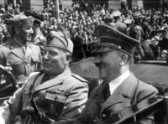
What is Fascism?
Features of Totalitarian States
Single Party dictatorship
State control of the economy
Use of police spies and terror to enforce the will of the state
Strict censorship and Govt. monopoly of the media
Use of schools and media to indoctrinate and mobilize citizens
Unquestioning obedience to a single leader

Slide 20
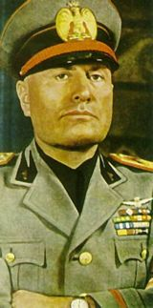
The Appeal of the Fascist State
Strong Govt.
Ended feuding
Intense national pride
Mussolini gave a sense of power and confidence to Italy
Outside nations praised Mussolini
Einstein, Freud and Gandhi praised as well
They later changed their minds
Notes:
People that praised Mussolini – Einstein, Freud, Gandhi – Their minds changed later on.

Slide 21
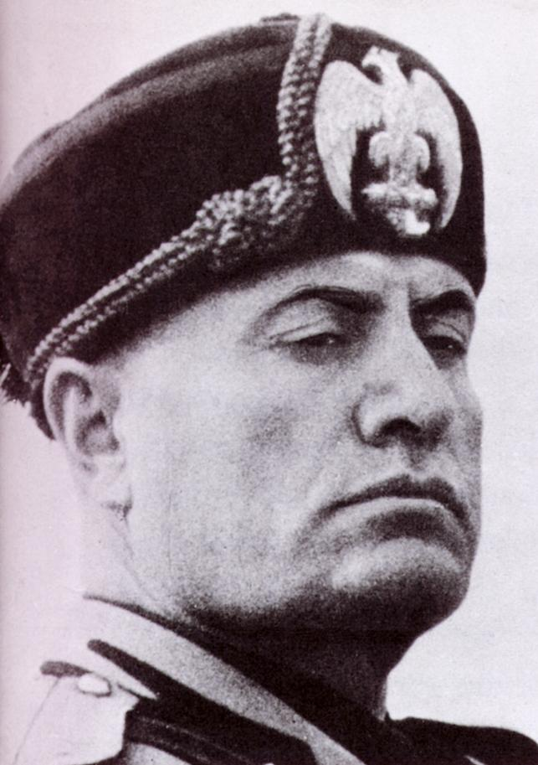
The Rise of Mussolini
Italy after the war
Upset with peace treaty
Economic and political turmoil
Fiery Speaker
Mussolini 1
When speaking he commands attention
Mussolini 2
1919 – organized veterans and other upset Italians into the Fascist party
Promised to end corruption and bring order to Italy
Promised to take Italy back to the days of Ancient Rome

Slide 22
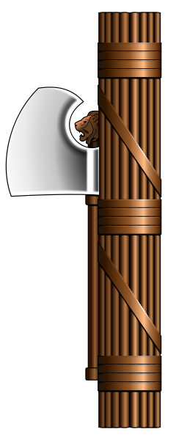
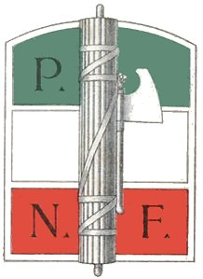
The Rise of Mussolini
Seizing Power
Mussolini organized “combat squads” called the Black Shirts.
Through terror and intimidation, got rid of elected officials in N. Italy
1922 – March on Rome
Fascists planned to march on Rome, demanding Govt. to make change
King Victor Emmanuel III wanted to avoid a civil war, offered Mussolini the position of Prime Minister

Slide 23
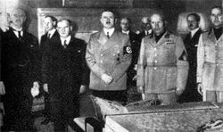
Mussolini’s Italy
Il Duce – “The Leader”
In theory Italy remained a parliamentary monarchy
In reality Italy was a dictatorship upheld by fascist violence and terror
Mussolini feels that democracy is weak
Economic Policy
Fascism allows capitalism
Economy comes under state control – corporate state
Economy will improve at the expense of workers
“The Trains always run on time”

Slide 24
Mussolini’s Italy
Social Policies
Glory of the state, not the individual
Slogan – “Believe! Obey! Fight!”
Men encouraged to be ruthless warriors
Women called to win the battle of motherhood…14 children medal
Women were not valued as workers
Gold wedding bands traded in for iron ones that represented their contribution to a stronger nation
Notes:
Mussolini felt that women should have as many male babies as possible. Mussolini gave a medal to women who had 14 children. Why would Mussolini want his people to have tons of children?

Slide 25
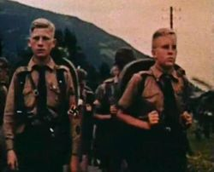
Mussolini’s Italy
Fascist Youth
Strict discipline – instill strong sense of patriotism
Youth group toughened children
Taught them to obey strict military discipline
Taught that Mussolini was always right
What is our American equivalent?

Slide 26
Hitler and the Rise of Nazi Germany
Notes:
Start with Hitler Video

Slide 27
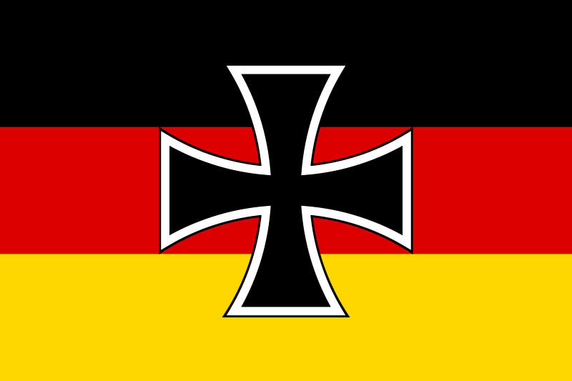
Struggles of the Weimar Republic
Weimar Republic signed the treaty of Versailles
Weimar Republic rules in between Kaiser Wilhelm II and Hitler
This government was too liberal and weak
Most Germans were angry with the Treaty of Versailles
Flag of Weimar Rep.

Slide 28
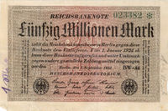
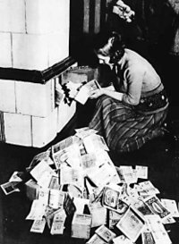
Struggles of the Weimar Republic
German money (Mark) went through serious inflation
Government begins to print a lot of money
Something that cost 100 marcs in 1919 cost 900,000 marks in 1924
The German economy begins to recover until the great depression hits

Slide 29
Adolf Hitler
Joins the Nazi party
Forms his group known as the Brown Shirts or Storm Troopers

Slide 30
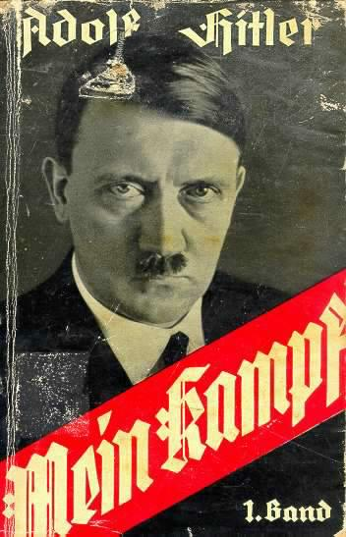
Adolf Hitler
Hitler writes Mein Kampf
Means “My Struggle”
His book spoke about how Aryan’s were the master race – It was very anti Semitic, racist and expressed extreme nationalism
Hitler said that Germany needed to expand to create living space for his people “Lebensraum”
Hitler gives himself the title of “Da Fuhrer”

Slide 31
Adolf Hitler
In 1933 Paul Von Hindenburg gives Hitler the title of Chancellor
Hindenburg thought this would help control the Nazi Party
Once in power Hitler eliminates civil rights, communists and socialists
Germany becomes a one party state

Slide 32
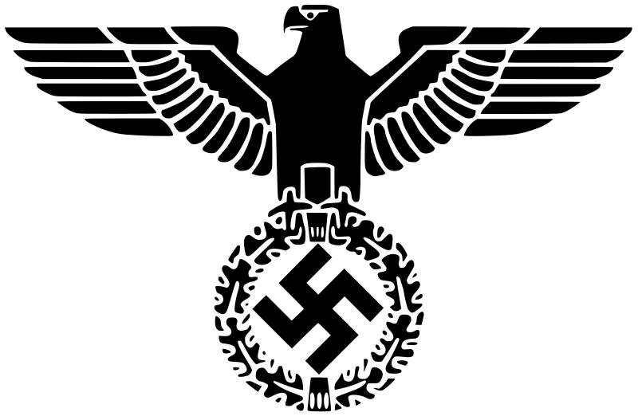
Hitler’s Third Reich
Hitler’s secret police enforced his policies
Hitler combated the great depression by implementing large public works programs
Highways, housing developments, autobahn, military build up
Unemployment goes down
Hitler encouraged his people to kill their enemies without mercy
Hitler used a great amount of propaganda to spread his cause

Slide 33
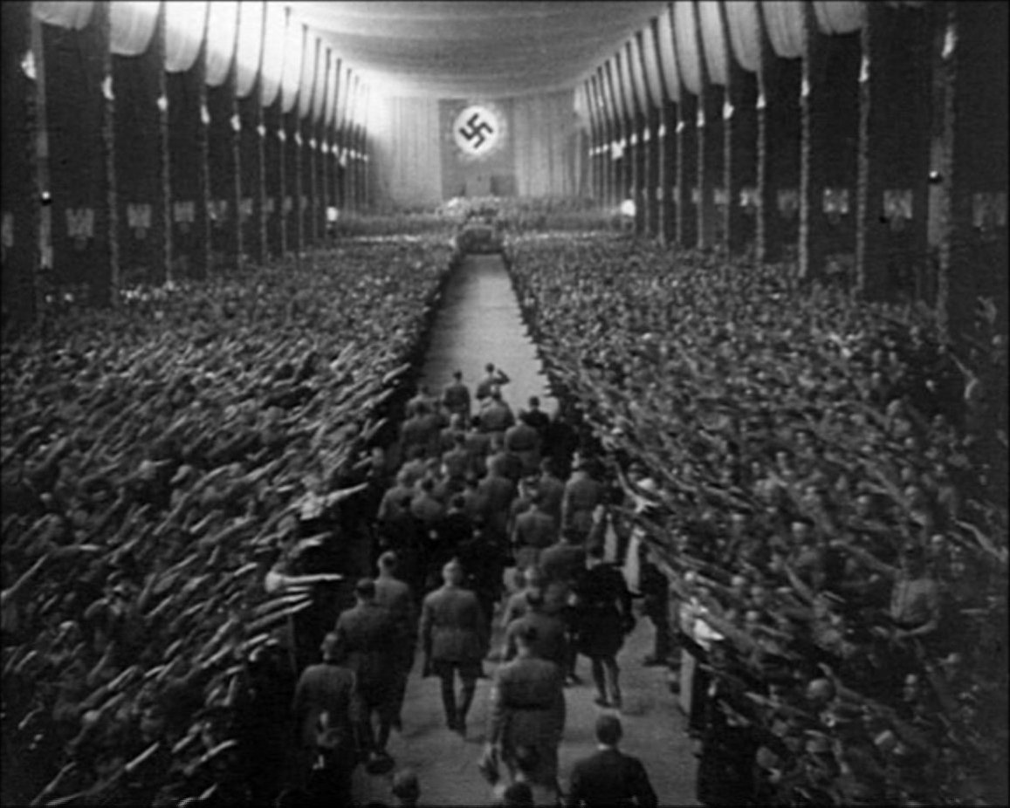
Triumph of the will
..\History Videos

Slide 34
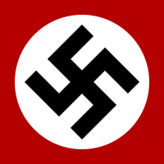
Purging German Culture
Nazi party burns many books that speak poorly of WWI
Hitler closes many churches
Hitler viewed churches as weak
Campaign against the Jews
1935 – Law passed in Germany stating:
Jews could not practice law
could not be in the Govt.
could not marry a non Jew
Could not attend school or teach
Could not publish books

Slide 35
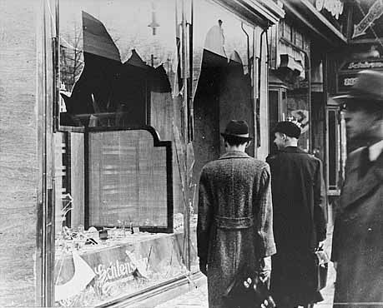
Purging German Culture
Night of Broken Glass
“Kristallnacht” – A young Jew killed a German diplomat in Paris – Nazi’s use this as an excuse to burn down Jewish synagogues and shops and killed thousands of Jews in the process
Many surrounding nations viewed this as a terrible event – this caused the Nazi’s to be more discreet in their persecution of the Jews

Slide 36
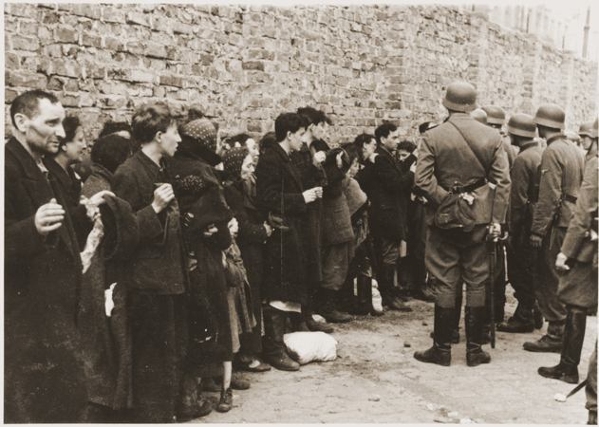
Hitler’s Final Solution
Hitler moves the Jews into Ghettos, then from Ghettos to concentration camps
The ultimate goal was to eliminate all Jews
pianist

